Slide 1
AWS Services
EC2 | VPC Endpoint | Control Tower | DirectConnect
AutoScaling | Service Endpoint | Landing Zone | RDS
Load Balancer | Site-to-Site VPN | Organization | DynamoDB
VPC | Client VPN Endpoint | CloudWatch | CloudFront
VPC Subnet | S3 Bucket | VPC Flow Log | Cost Explorer
Route53 | EKS/ECS/Fargate | CloudTrail | Migration Hub
Internet Gateway | IAM | API Gateway | Server Migration
NAT Gateway | Single Sign On | System Manager | DB Migration
Transit Gateway | Cognito | EFS | App Migration
VPC Peering | Lambda | FSx | Storage Gateway

Slide 2
AGW vs ALB
Can implement rate limit and bursting for APIs | No rate limiting and bursting capability
Not possible to get static IP for endpoint | Possible to get static IP address for load balancer endpoint
Accept only HTTPS traffic | Accept HTTP and HTTPS traffic
Able to do request validation, request/response mapping | Not able to to do request validation, request/response mapping
Can integrate with Lambda across the region and across the account | ALB is a regional service
Able to cache responses | No option for response cache
Timeout limit 30 seconds | Timeout limit 4000 seconds
Can integrate with almost all AWS services | Use EC2, Lambda & IP Address only
No health check available | Health check available
Pay per use | Pay for idle
AGW vs ALB

Slide 3
CloudWatch vs CloudTrail
CloudWatch is monitoring service AWS resources & application | CloudTrail is web service that is mainly concerned with what is done in AWS account by whom and when
Using CloudWatch we can track metrics and monitor logs | CloudTrail gives more visibility into user activity AWS console actions, who made call from which IP & when
CloudWatch records the application logs | CloudTrail provides information what occurred in given AWS account
CloudWatch gives metric data in 1 minute period for detailed monitoring and 5 minutes period for basic monitoring | CloudTrail delivers an even in within 15 minutes of the API call
CloudWatch by default stores data in its own dashboard in form of metrics and logs | CloudTrail centralized all logs across the region and stores them in an S3 bucket

Slide 4
VPC & Subnet Quota
Name | Default | Adjustable | Comments
VPCs per Region | 5 | Yes | Increasing this quota increases the quota on internet gateways per Region by the same amount. You can increase this limit so that you can have 100s of VPCs per Region.
Subnets per VPC | 200 | Yes
IPv4 CIDR blocks per VPC | 5 | Yes (Up to 50) | This primary CIDR block and all secondary CIDR blocks count toward this quota.
IPv6 CIDR blocks per VPC | 1 | No

Slide 5
Gateways
Name | Default | Adjustable | Comments
Internet gateways per Region | 5 | Yes | To increase this quota, increase the quota on VPCs per Region. You can attach only one egress-only internet gateway to a VPC at a time.
NAT gateways per Availability Zone | 5 | Yes | To increase this quota, increase the quota on VPCs per Region. You can attach only one internet gateway to a VPC at a time.
Egress-only internet gateways per Region | 5 | Yes | NAT gateways count toward your quota in the pending, active, or deleting state.

Slide 6
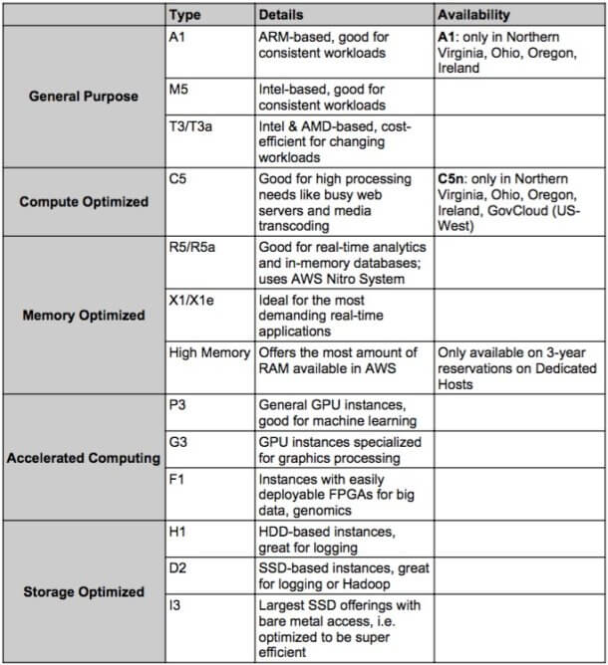
Instance Type

Slide 7
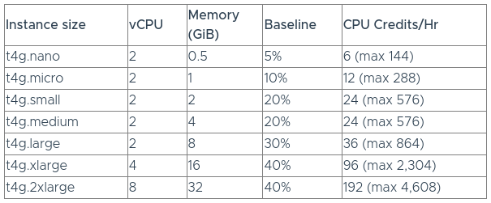
T Family Burstable CPU
Burstable instances are an AWS instance family with unique feature, which guarantee a level of CPU performance, but they also have the ability to burst through the “baseline” level of performance to sustain a high CPU performance level for as long as a workload needs it. The difference between a burstable instance and a standard instance is that burstable instances have a “baseline” level of performance per vCPU, and when the instance is operating below the baseline level, it earns CPU credits.
For example, a t4g.large burstable instance will earn 36 CPU credits an hour when instance utilization is 0%, but only 18 CPU credits per hour when the instance is operating at 15% (half its baseline percentage).

